Slide 1
Week #15 NPU_CS522Automation Amazon Automation Tool
By <team members>

Slide 2
Use case
Open Amazon page and search camera it will display camera’s list and find the camera which we want to buy and add that camera to cart for purchase.

Slide 3
Design
Using Page Object Model
Automation test case will open amazon.com
Search for camera and find list of cameras
It will check “Canon Powershot SX410 IS Black Digital Camera and 32GB Card Bundle - ” is present or not
It clicks on found camera “Canon Powershot SX410 IS Black Digital Camera and 32GB Card Bundle –”
Click to Add to cart.

Slide 4
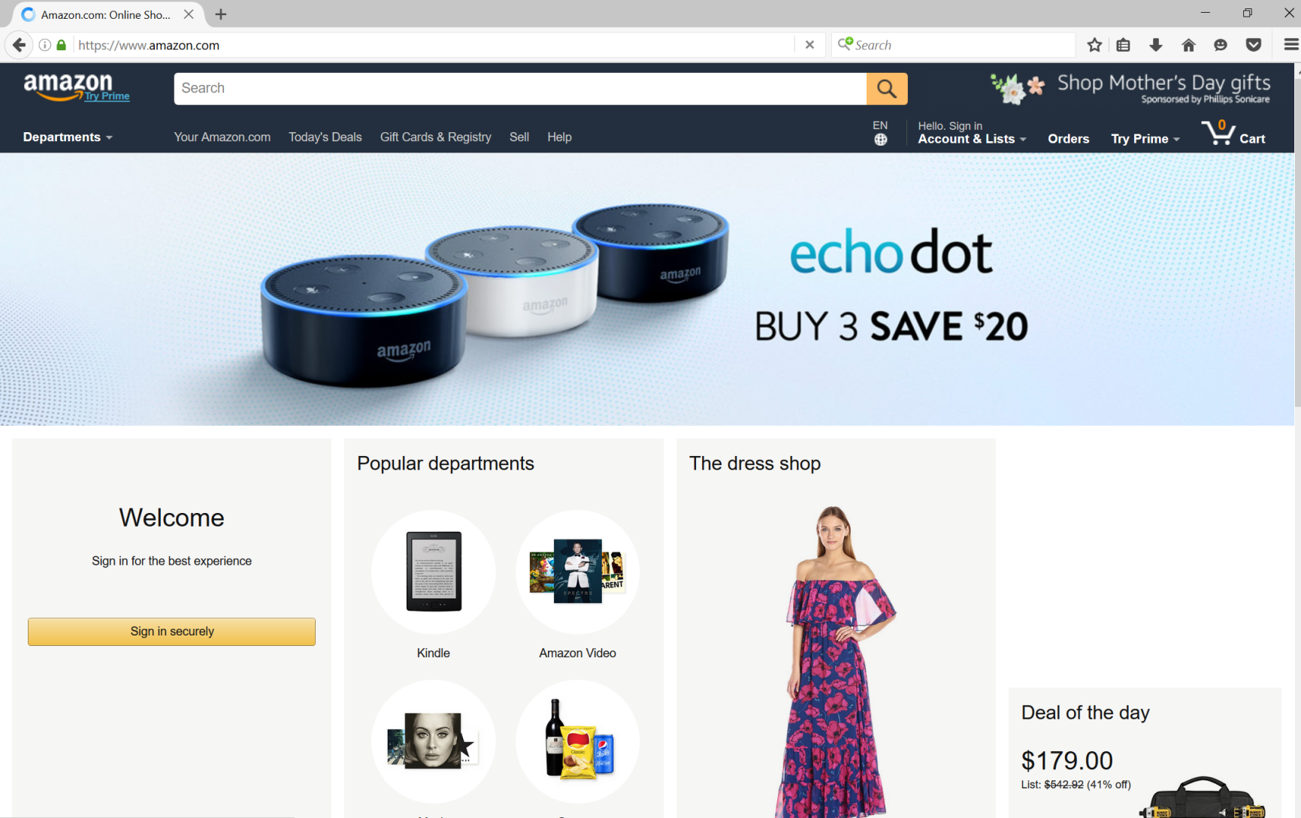
Demo

Slide 5
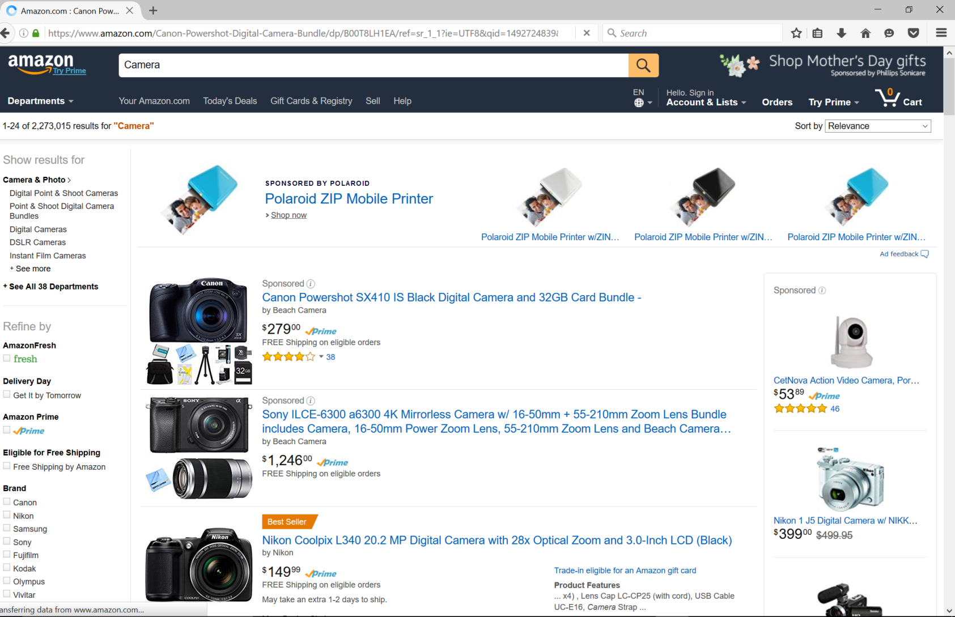
Search Camera

Slide 6
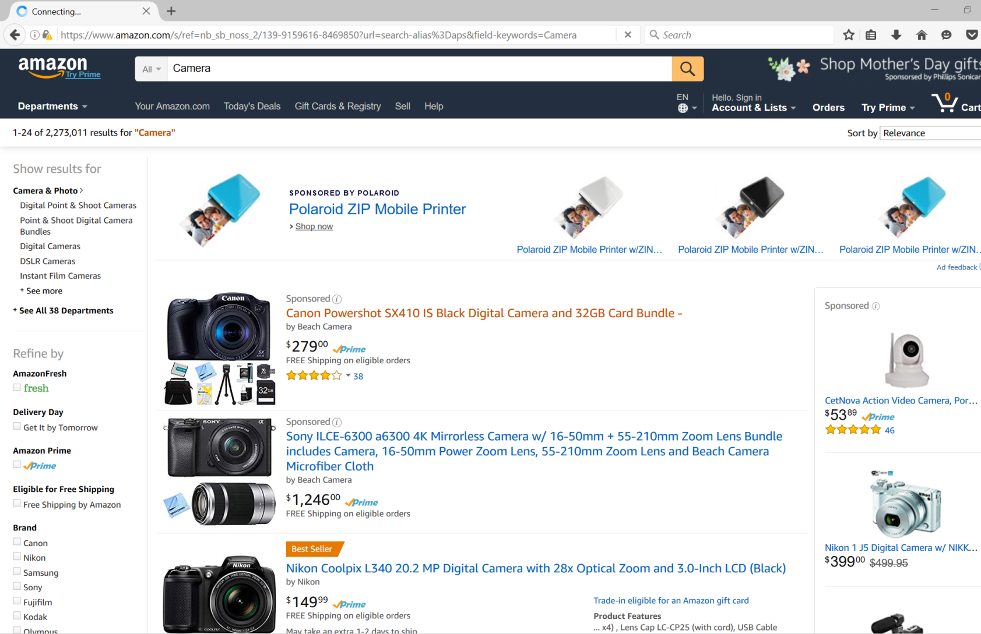
Click on canon Powershot Camera

Slide 7
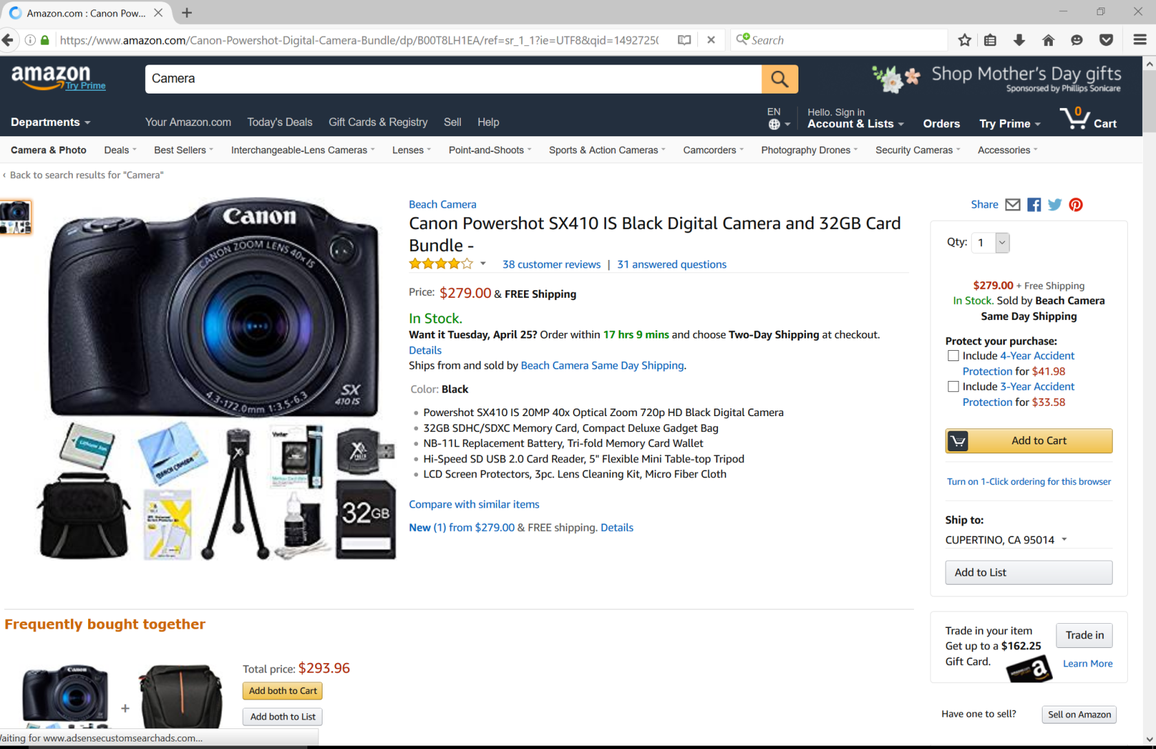
Displayed Camera

Slide 8
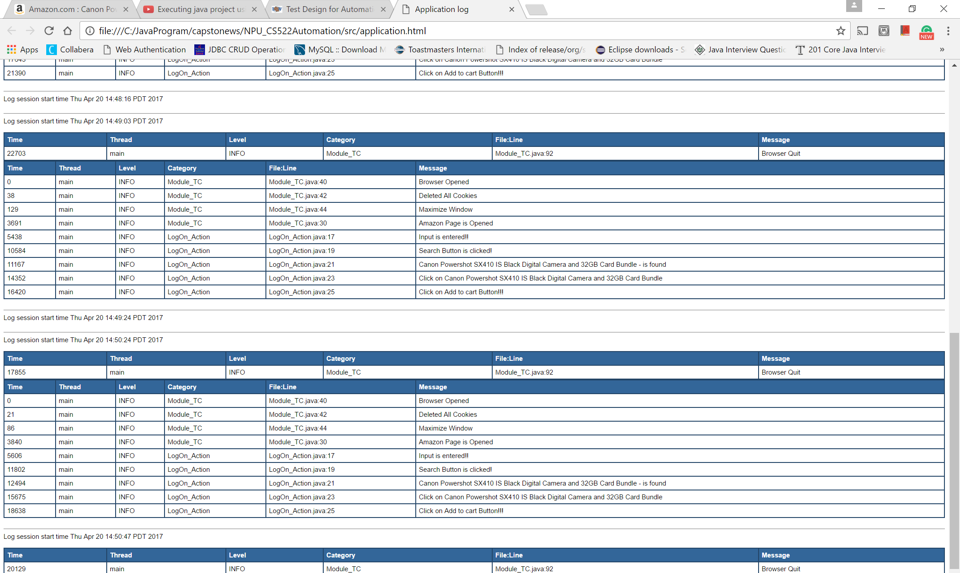
HTML Report

Slide 9
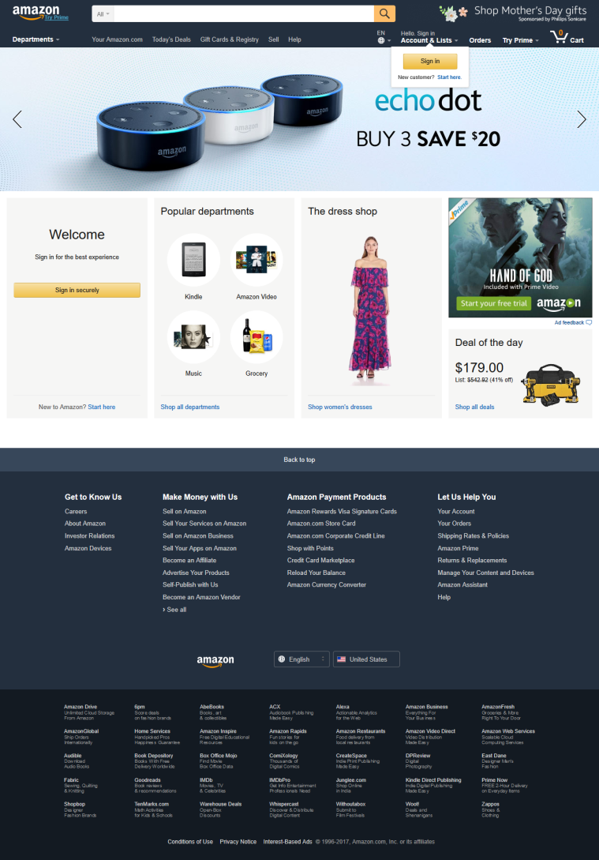
Screen Shots

Slide 10
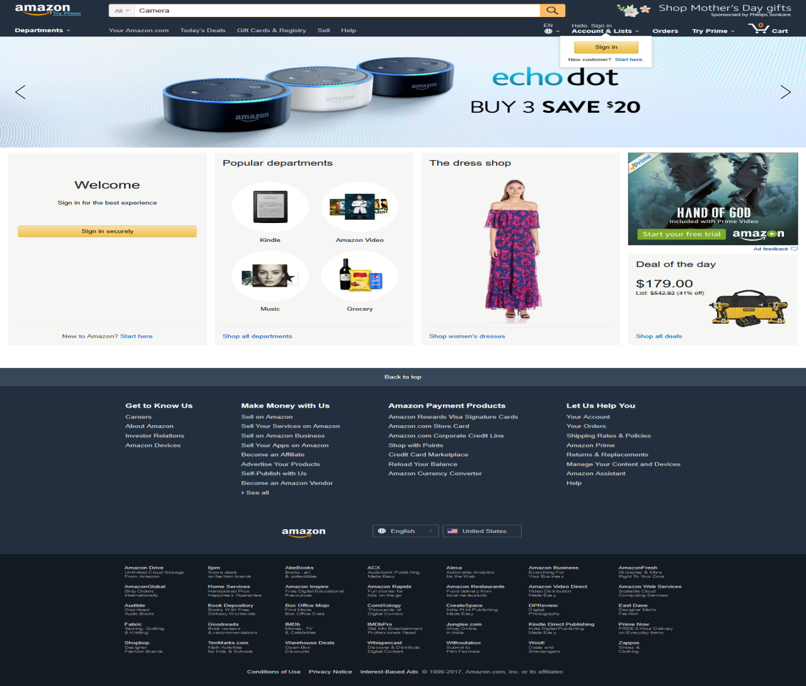

Slide 11
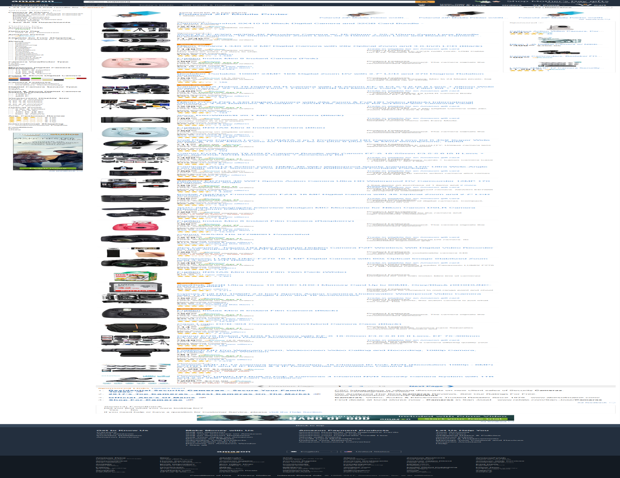

Slide 12
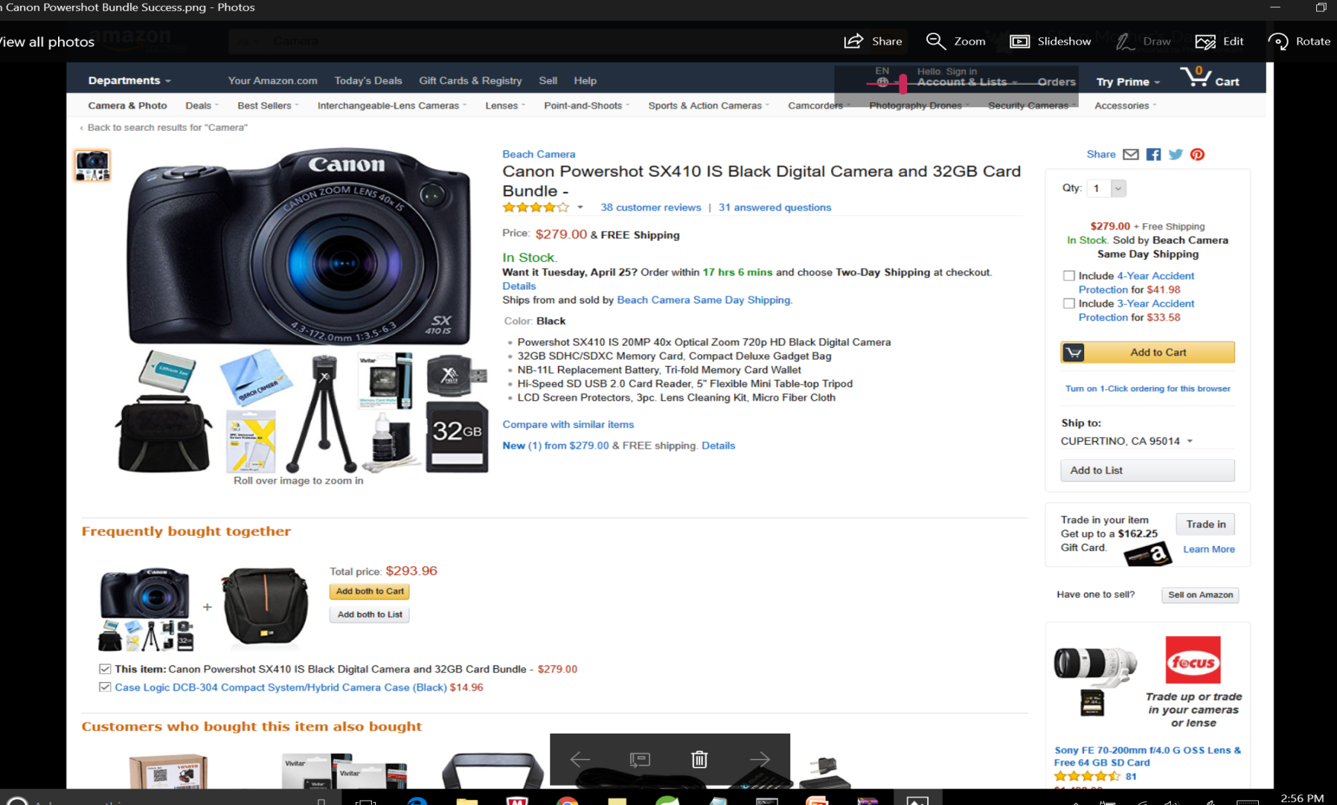

Slide 13
